Slide 1


UBER DATA ANNALYSIS PROJECT REVIEW 2
Presented By-
1.mohit samal (1801104139)
2.Abinash jena (1921104019)
3.Ashutosh Malla (1921104021)
4.Soumya prajna Behera (1921104032)
Guided by-
Mrs. sasmita pani
HI SARS!!!

Slide 2
CONTENTS
Overview
Technologies Used
Partial Implementation Of The Project
Errors and Bugs Identified And Its Solutions
References

Slide 3
OVERVIEW
The process of data analysis uses analytical and logical reasoning to gain information from the data.
The main purpose of Uber data analysis is to find meaning in data so that the derived knowledge can be used to make informed decisions

Slide 4
TECHNOLOGIES USED
Tools used:
A computer system running on Windows
VS code was installed for editing all the Python codes.
Jupyter Note book was installed in VS code
Techniques, Languages used:
Python
Numpy
Pandas
Matplotlib
Seaborn

Slide 5
PARTIAL IMPLEMENTATION OF THE PROJECT
Installation of Virtual studio code was done.
Installation of Python was done.
All the modules required for project like PANDA,NUMPY,MATPLOTLIB were installed.
Installation of Jupyter notebook was done in vs code.
Collection of data set of uber was done

Slide 6
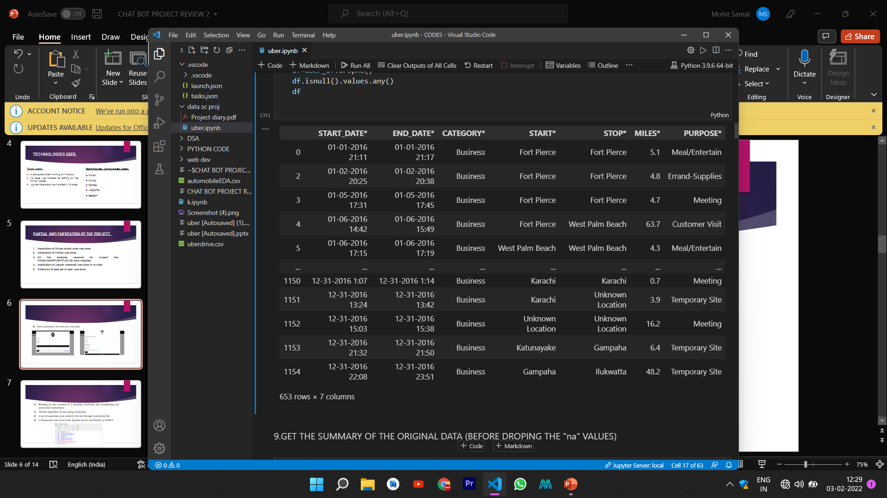
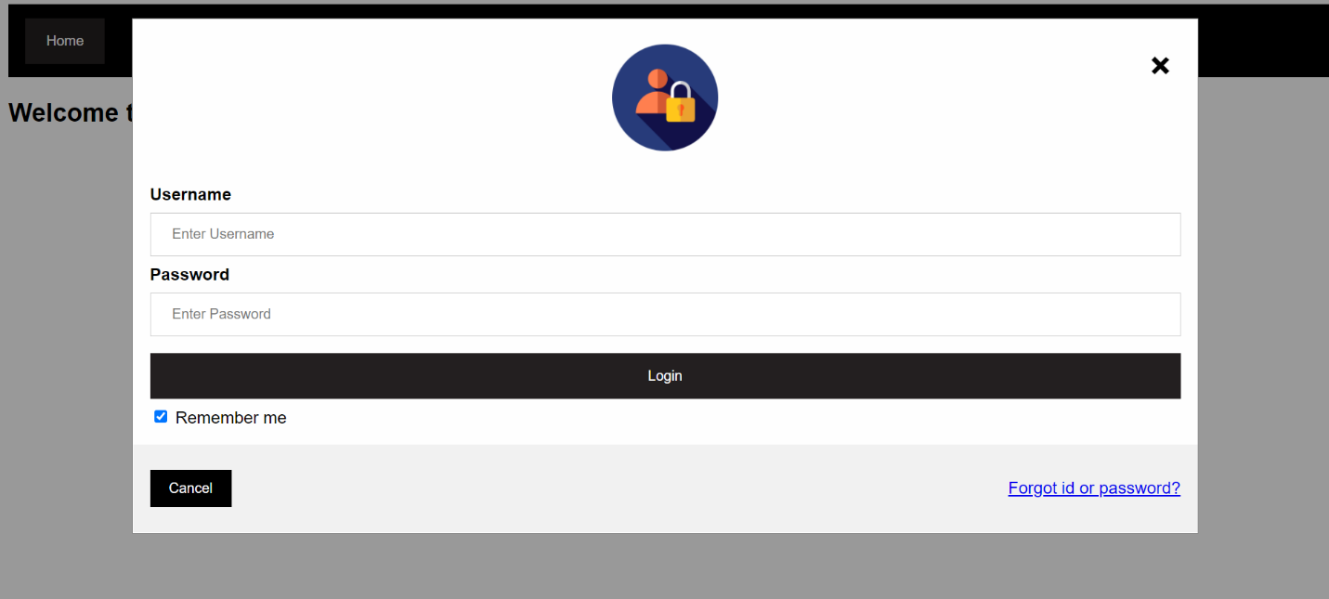
Data cleaning of the data set was done

Slide 7
Then we annalyse the data by various objective like
SHOW THE FIRST 10 RECORDS OF THE DATA SET
SHOW THE LAST 10 RECORDS OF THE DATA SET
SHOW THE DIMENSION OF THE DATASET
SHOW THE SIZE OF THE DATA SET
PRINT THE INFORMATION ABOUT ALL THE VARIABLES OF THE DATA SET
CHECK FOR MISSING VALUSE(IS THERE ANY,ANS IN TRUE FALSE)
HOW MANY MISSING VALUES ARE PRESENT
GET THE INITIAL DATA(NAME IT df) WITH DROPING THE NA VALUES
GET THE SUMMARY OF THE ORIGINAL DATA (BEFORE DROPING THE "na" VALUES)

Slide 8
CHECK THE INFORMATION OF THE NEW DATA FRAME
GET THE UIQUE START DESTINATION/ arrange alphabatically
PRINT THE TOTAL NUMBER OF UNIQUE START DESTINATION
PRINT THE TOTAL NO OF UNIQUE STOP DESTINATION
PRINT ALL THE UBER TRIPS THAT HAS THE STARTING POINT OF SAN FRANSSICO
WHAT IS THE MOST POPULAR STARTING POINT OF THE UBER DRIVES
WHAT IS THE MOST POPULAR STOPING POINT OF THE UBER DRIVES

Slide 9
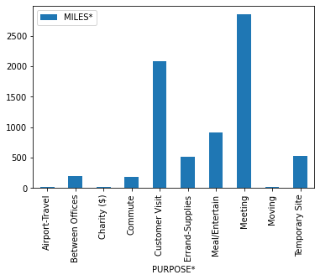
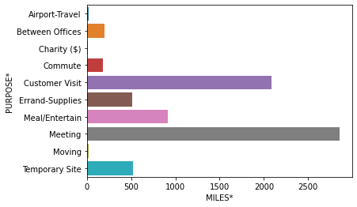
LIST THE MOST FREQUENCE ROUTE IS TAKEN BY UBER DRIVES
PRINT ALL TYPE OF PURPOSES FOR THE TRIP IN AN ARRARY WITH MILES
PLOT A BAR GRAPH OF PURPOSES VS DISTANCE

Slide 10
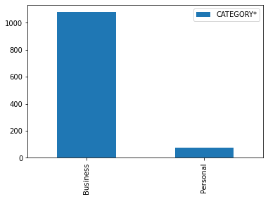
PLOT NUMBER OF TRIPS VS CATEGORY OF TRIPS

Slide 11
22.WHAT IS PROPORTION OF TRIPS THAT IS BUSINESS AND WHAT IS THE PROPORTION OF TRIPS THAT IS PERSONAL
23.CONVERT THE DATE AND TIME IN FORMAT OF HOUR ,DAY, MONTH,WEEKDAY

Slide 12
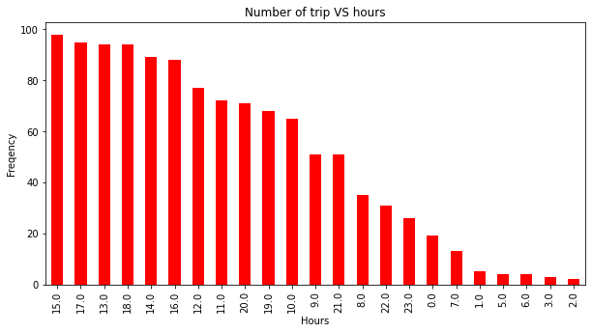
WHAT HOURS DO MOST PEOPLE TAKE UBER TO THEIR DESTINATION?

Slide 13
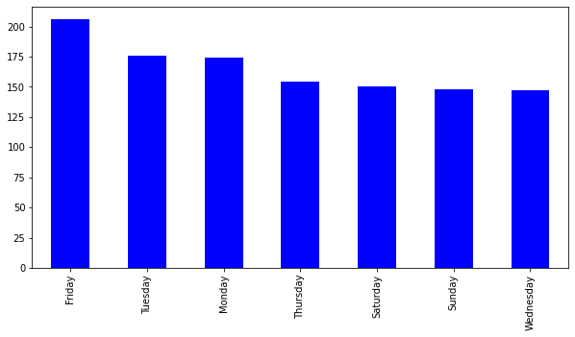
Which Day/WeekDay Has The Highest Number Of Trips?

Slide 14
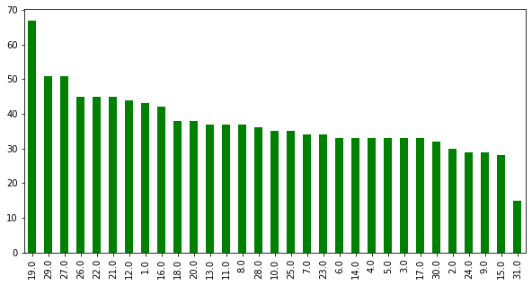
What Are The Number Of Trips Per Each Day?

Slide 15
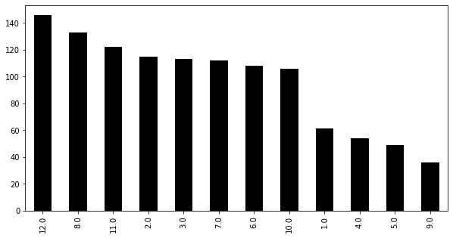
What Are The Trips In The Month

Slide 16
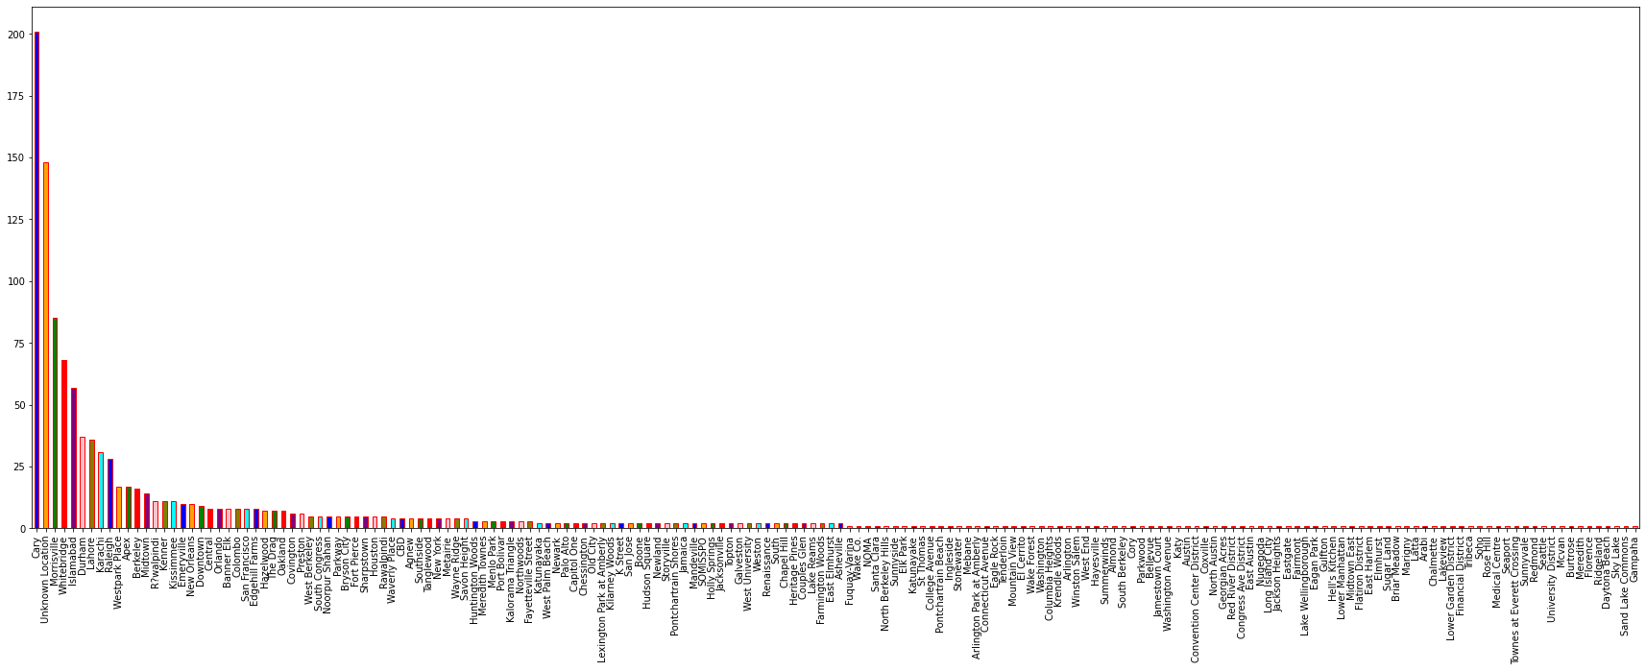
The starting points of trips. Where Do People Start Boarding Their Trip From Most?

Slide 17
ERRORS OR BUGS IDENTIFIED AND ITS SOLUTIONS.
1.Cant load the csv file using panda in virtual studio code Warning:unable to open Uberdrive.csv
Solution-first we were importing it from internet directly.Then after the error we download the data set and give the complete path of the data set
2. During calculation of total number of unique start destination ,we use a predefine function count()
Warning:attribute error,set object has no attribute count
Solution-Count() cant be used in set so we use len()

Slide 18
3. Whenever we open vs code and continue our work from where we end last time code doesn’t run
NameError: name 'uber_df' is not defined
Solution-every time you open editor to continue work you have to first run the 1st code cell where you import module and read the data frame
4. When we convert the date and time in format of HOUR,DAY,MONTH,WEEK DAY
code gives
ValueError: time data '01-01-2016 21:11' does not match format '%m/%d/%Y %H:%M' (match)

Slide 19
Solution- first we have to change the data of STARTDATE ,ENDDATE in the format of %m-%d-%Y in Excel then run it.

Slide 20
REFERENCE
[1]Wes McKinney,”Python for data analysis 1st eddition”,pp.9-34,2012
[2] Wes McKinney,”Python for data analysis 2nd eddition”,pp.67-83,2017
[3] Mrunal Patil1, Vidya Kumari, Adarsh Patil, Laxmikant Ahire and Asst.Prof. Umakant Mandawkar ,” UBER DATA ANALYSIS USING GGPLOT” Dept. Computer Science and Engineering, Sandip University, Nashik, July 2012
[4]https://www.skyfilabs.com/project-ideas/uber-data-analysis
[5]https://www.uber.com/us/en/careers/teams/data-science/
[6]https://iedu.us/tag/project-in-r-uber-data-
analysis-project/
[7]https://colab.research.google.com/drive/1igWmyXur60I_etxsf6N7jV8PTbQou5BU?usp=sharing
[8] https://github.com/zaidjamal-op/UBER-data-analysis-machine-learning
/blob/main/Uber%20data%20analysis/UBER%20Data%20analysis.ipynb
[9] https://coursera.org/learn/data-analysis-with-python

